Slide 1



ACCESS-ESM1.5:
Southern Hemispheric Monsoons
at the Last Interglacial
Nicholas K.H. Yeung
Laurie Menviel, Katrin J. Meissner, Andréa S. Taschetto, Tilo Ziehn, Matthew Chamberlain
Yeung, N. K.-H., Menviel, L., Meissner, K. J., Taschetto, A. S., Ziehn, T., and Chamberlain, M.: Land–sea temperature contrasts at the Last Interglacial and their impact on the hydrological cycle, Clim. Past, 17, 869–885, https://doi.org/10.5194/cp-17-869-2021, 2021.

Slide 2
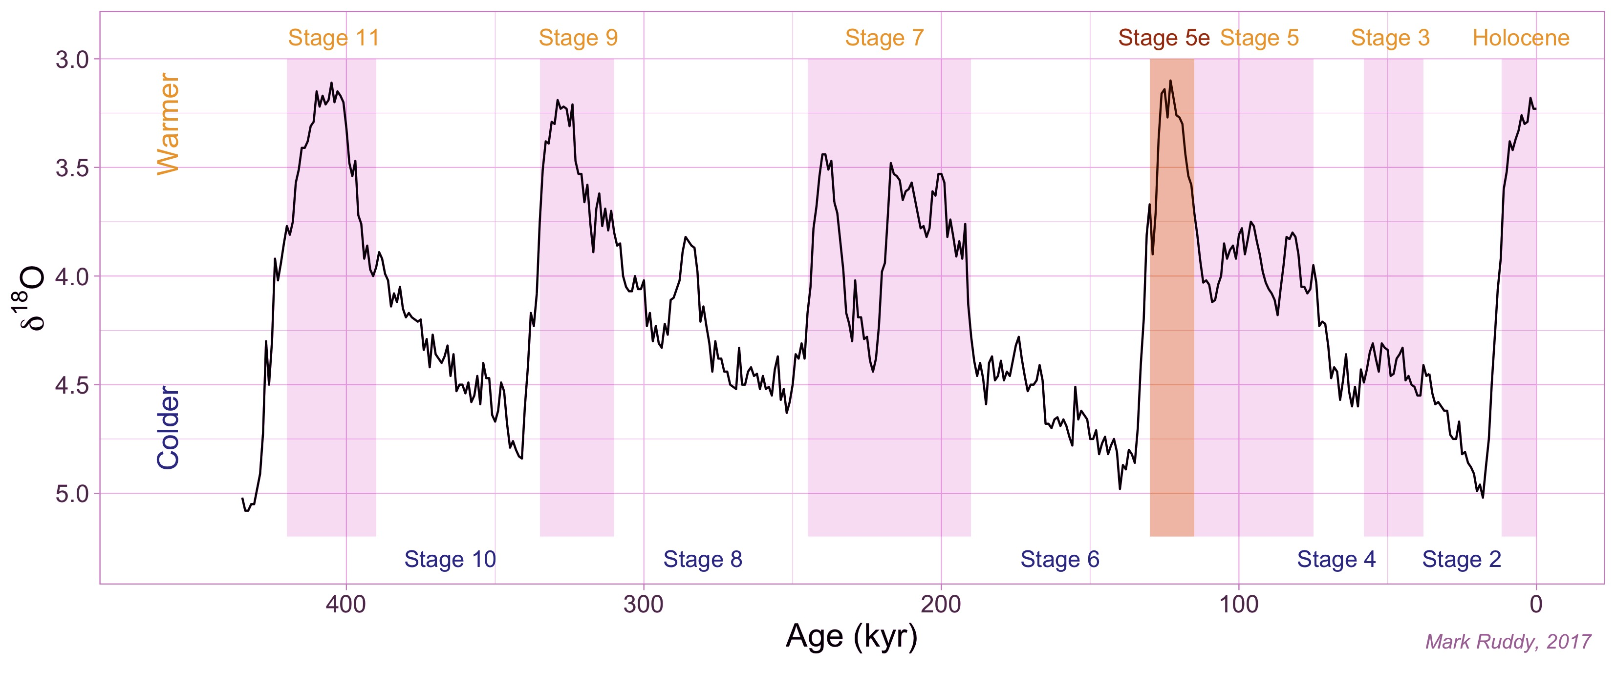
The Last Interglacial (LIG)
~129,000 - 116,000 years before present
Sea-level 6-9 m higher than present
LIG
PI (1850CE)
Lower Sea-level Higher
400,000
300,000
Age (yr)
200,000
100,000
Notes:
Larger eccentricity
Timing of perihelion closer to boreal summer solstice
Greater axial tilt
Climatic feedbacks not well understood during LIG
Explain axis
Not sure why the south is warm, antarctica is losing ice

Slide 3
The Last Interglacial (LIG)
~129,000 - 116,000 years before present
Sea-level 6-9 m higher than present
Compared to pre-industrial (PI; 1850CE):
Northern high latitude summer SST ~1.1°C warmer
Peak global annual mean SST ~0.5°C warmer
Greenhouse gas concentrations slightly lower
Most climate forcing, except orbital configurations, were relatively similar
LIG
PI (1850CE)
Lower Sea-level Higher
400,000
300,000
Age (yr)
200,000
100,000
Notes:
Larger eccentricity
Timing of perihelion closer to boreal summer solstice
Greater axial tilt
Climatic feedbacks not well understood during LIG
Explain axis
Not sure why the south is warm, antarctica is losing ice

Slide 4
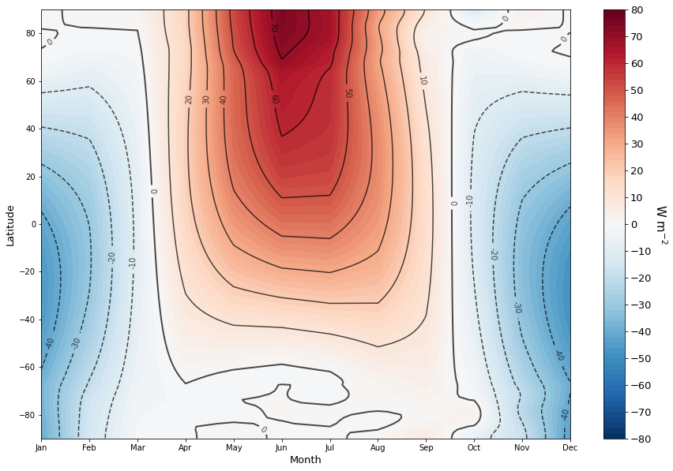
The Last Interglacial (LIG)
~129,000 - 116,000 years before present
Latitude-month insolation anomalies in LIG (127ka – 1850CE)
Notes:
Larger eccentricity
Timing of perihelion closer to boreal summer solstice
Greater axial tilt
Climatic feedbacks not well understood during LIG
Explain axis
Not sure why the south is warm, antarctica is losing ice

Slide 5
The Last Interglacial (LIG)
~129,000 - 116,000 years before present
Latitude-month insolation anomalies in LIG (127ka – 1850CE)
Equilibrium experiment (lig127k) using ACCESS-ESM1.5
A part of CMIP6-PMIP4
Mean state of LIG, with particular focus on Southern Hemisphere
Control experiment (pre-industrial) by CSIRO
Notes:
Larger eccentricity
Timing of perihelion closer to boreal summer solstice
Greater axial tilt
Climatic feedbacks not well understood during LIG
Explain axis
Not sure why the south is warm, antarctica is losing ice
Complexity and resolution allows study on SH monsoons and ENSO
Vegetation is prescribed and fixed, but leaf area index (LAI) is dynamic.
In a paleo perspective, relative high resolution to look at climate regional climate variability

Slide 6
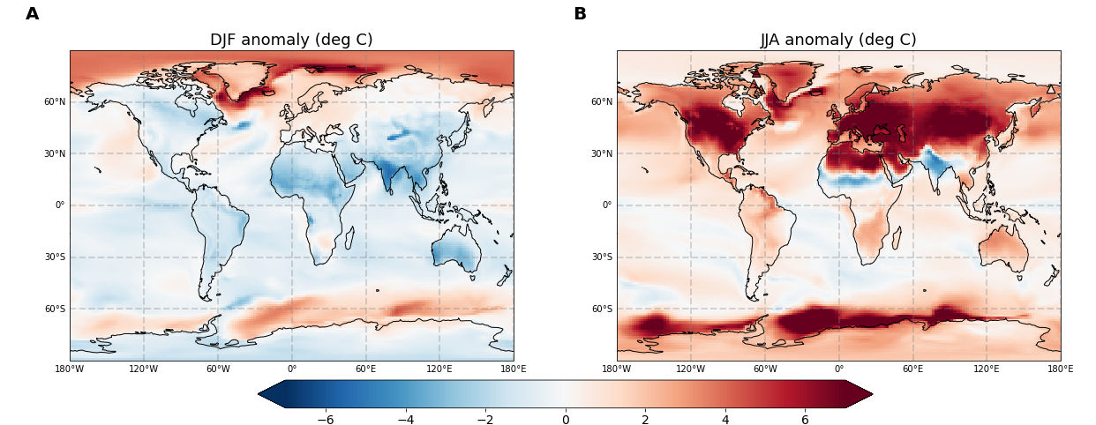
Surface air temperature anomaly in LIG compared to PI

Slide 7
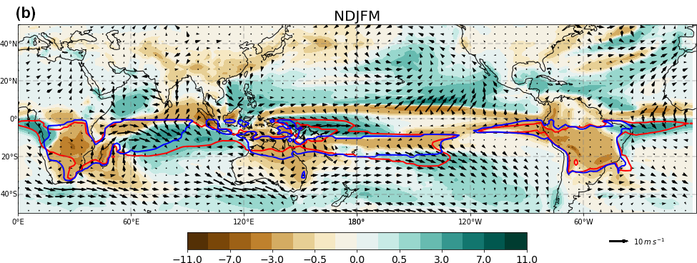
DJF precipitation anomaly (mm/day)
––– LIG
––– PI
Notes:
Text box for different bars

Slide 8
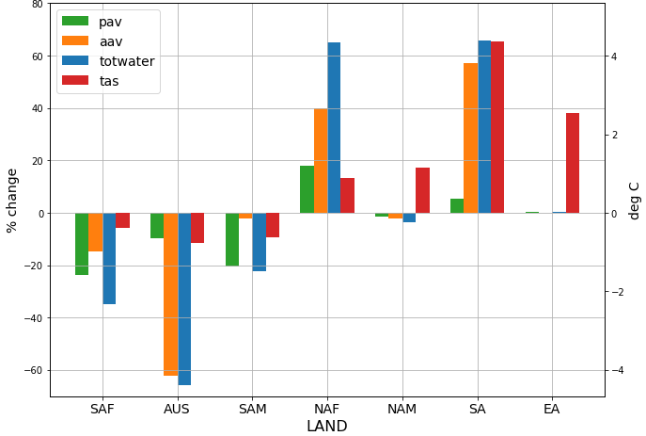
DJF precipitation anomaly (mm/day)
––– LIG
––– PI
area-averaged precip.
areal extent
total precipitated water
surface air temp.
Changes in precipitation and temperature in monsoon domains over land during monsoon season
S.H.
N.H.
Notes:
Text box for different bars

Slide 9
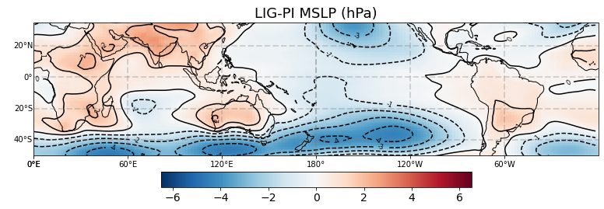
DJF precipitation anomaly (mm/day)
––– LIG
––– PI
Notes:
Text box for different bars

Slide 10
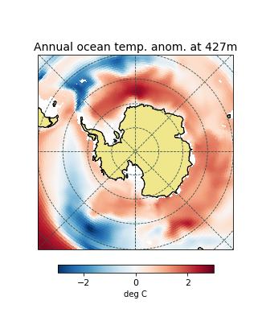
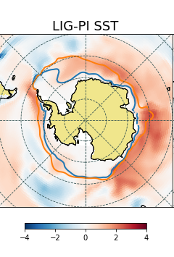
Current focus: Ocean processes that contribute to Southern Ocean warming during LIG
deg C

Slide 11
Extra plots

Slide 12
Summary
LIG mainly differs from PI in terms of insolation distribution.
Equilibrium experiments simulating LIG and PI have been performed using ACCESS-ESM1.5.
SH monsoons are consistently weakened, while precipitation over SH tropical oceans increases.
Drier conditions over SH land are due to reduced land-sea temperature contrast, and greater subsidence as SH Hadley cell strengthens.
Results published in Climate of the Past:
Yeung, N. K.-H., Menviel, L., Meissner, K. J., Taschetto, A. S., Ziehn, T., and Chamberlain, M.: Land–sea temperature contrasts at the Last Interglacial and their impact on the hydrological cycle, Clim. Past, 17, 869–885, https://doi.org/10.5194/cp-17-869-2021, 2021.

Slide 13
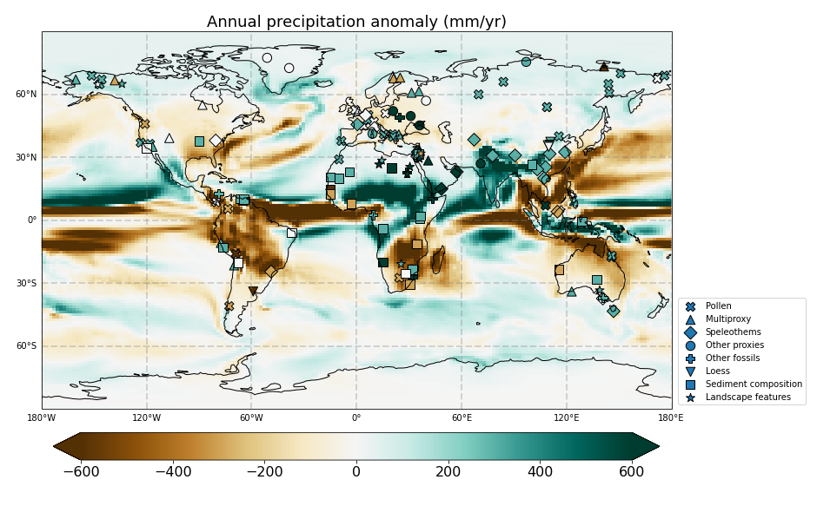
Scussolini et al. 2019
Notes:
Precip proxy not quatitative!

Slide 14
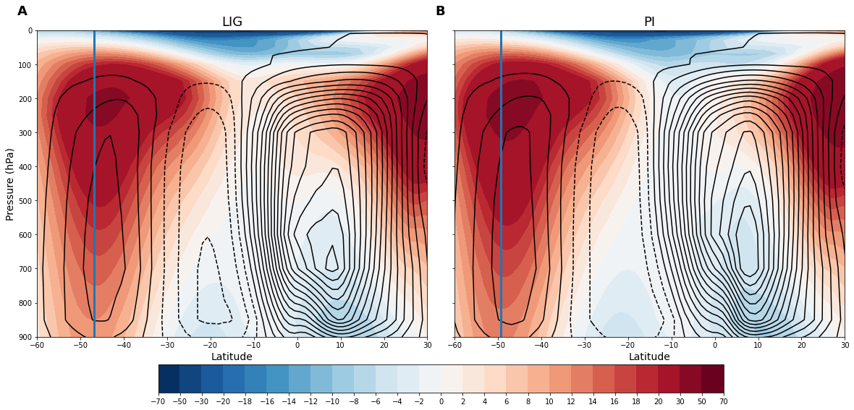
DJF zonal wind and mass stream function
m/s

Slide 15
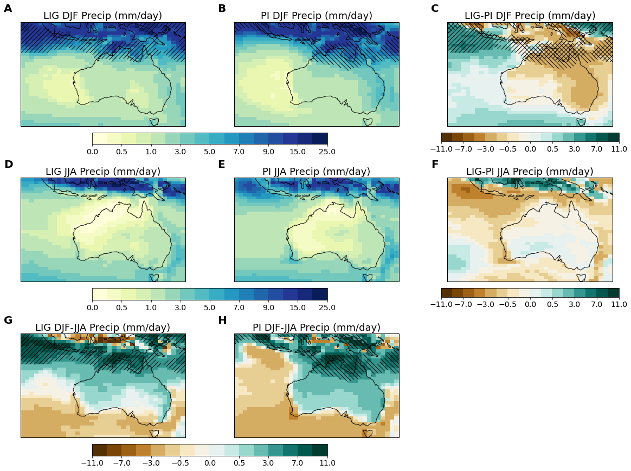
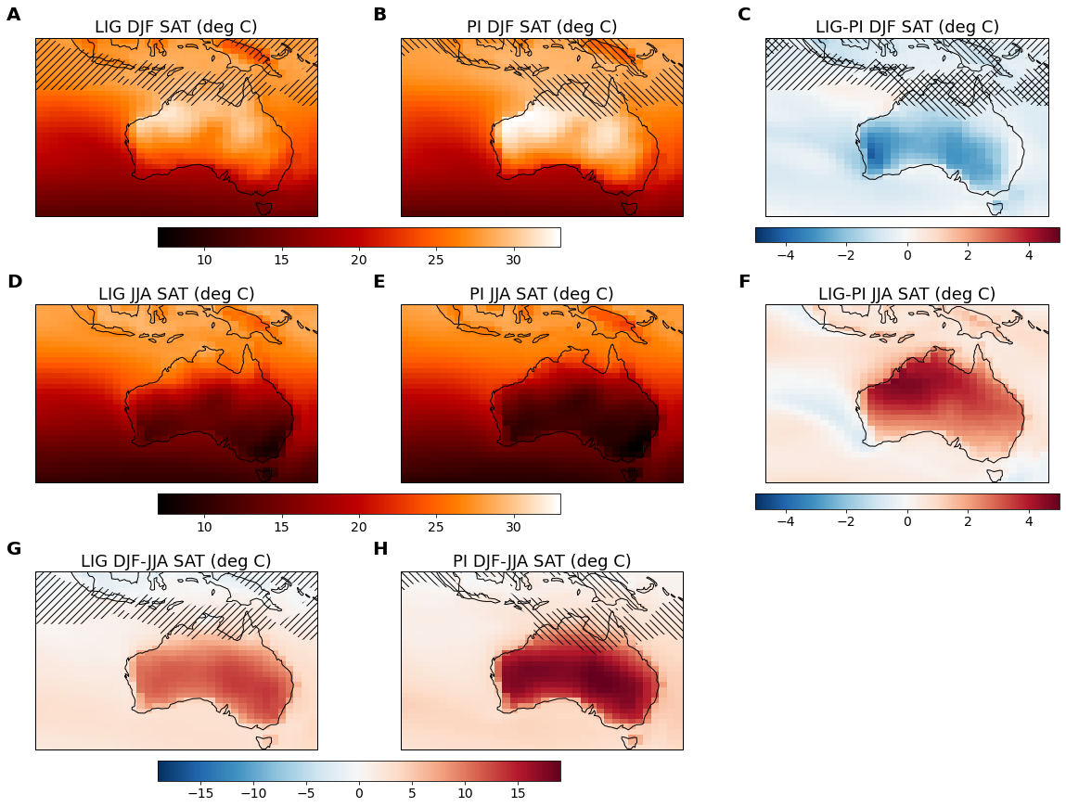
Monsoon domains: /// for LIG, \\\ for PI
Notes:
Keep C and F only

Slide 16
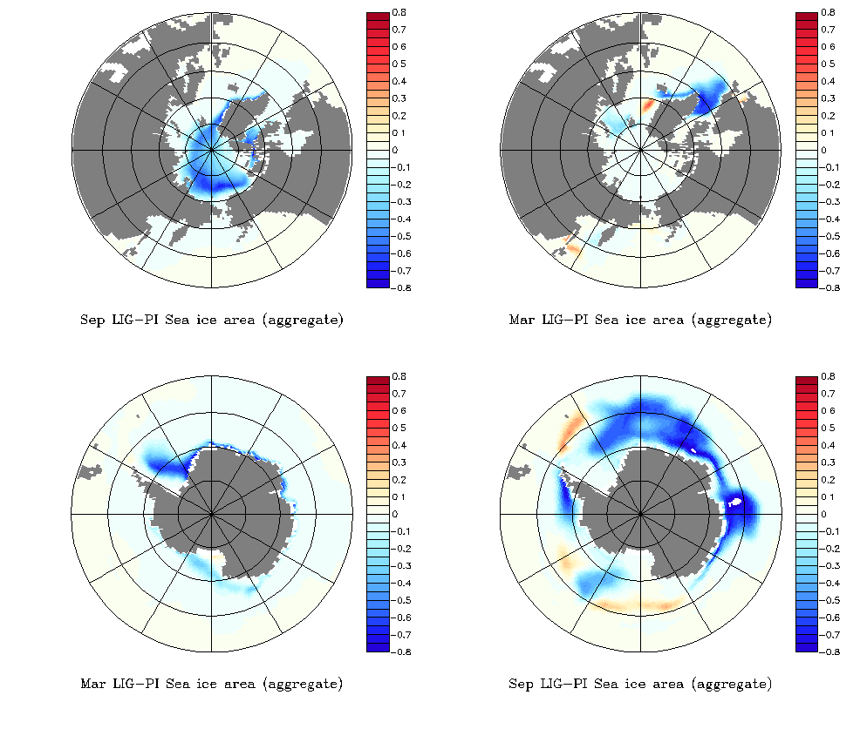
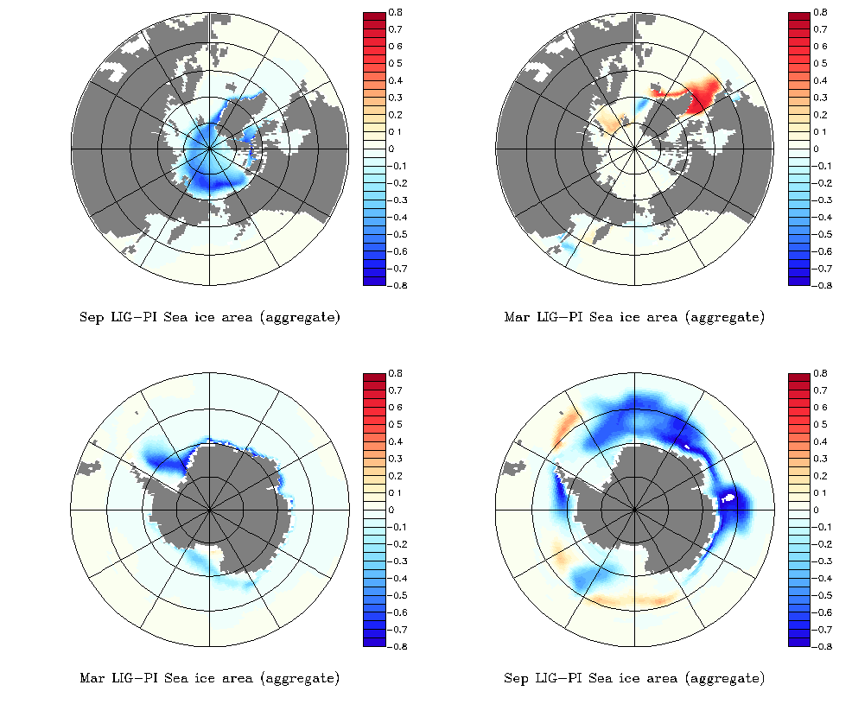
Sea-ice Area
Mar (LIG-PI)
Sep (LIG-PI)
Notes:
Memory effect?
Look at mixed layer depth (south of greenland after winter)

Slide 17
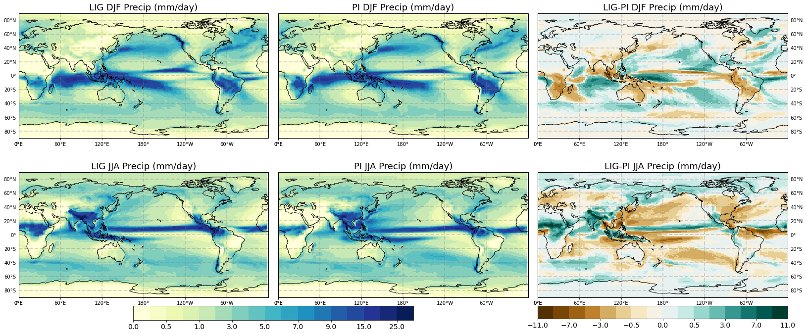

Slide 18
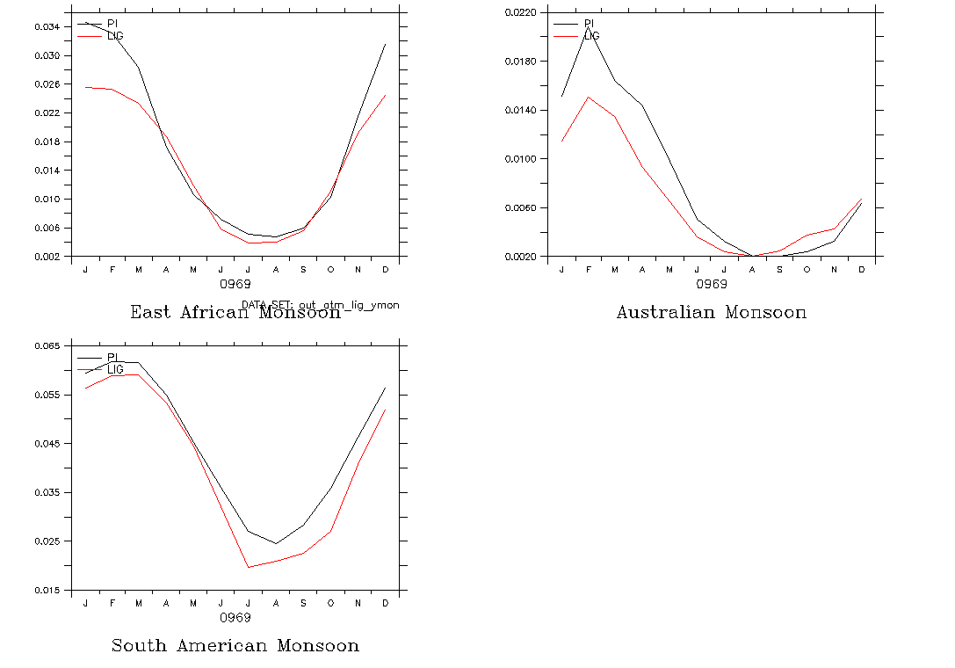

Slide 19
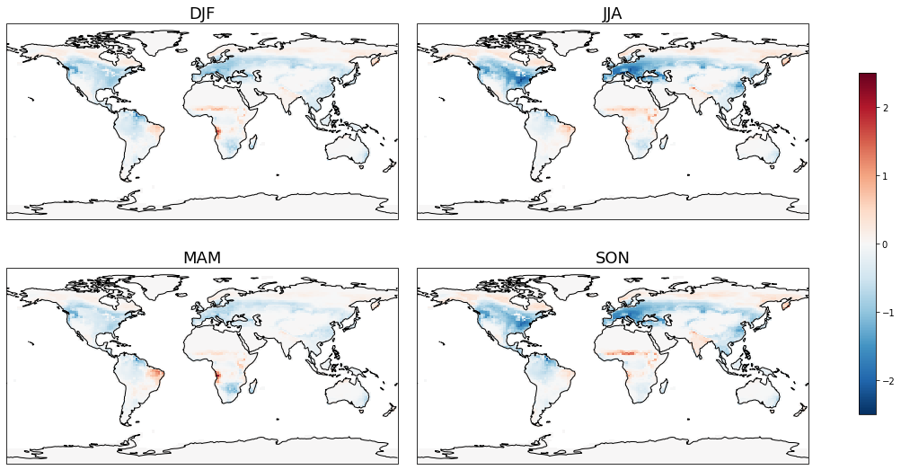
LAI

